Slide 1
Sentimental Analysis of hotel reviews
in
Europe
Sanjay Kumar
Harsha Biddappa M S

Slide 2
Project Plan
Business Understanding
Data Understanding
Data Challenges
Modelling
Evaluation
Deployment

Slide 3
Business Objective
Our business objective is to provide the best hotels for accommodation throughout Europe, by analysing the reviews given by the previous visitors stayed in the hotels between 2015 and 2017.
On the basis of the reviews available, hotel popularity will be improved.
Improve Hotel Performance
Improve Areas which are highly Targeted in Negative Reviews

Slide 4
Data Mining Goals
Get Data Clean
Get Data Insight
Find Suitable Model for Business Purpose.

Slide 5
Data Challenges
Big Data
Unlabelled Data
Labelling Data by manually
Missing Data , Data type
Main Challenge, we have two columns Positive and Negative Review
Features weightage (TF-IDF)

Slide 6
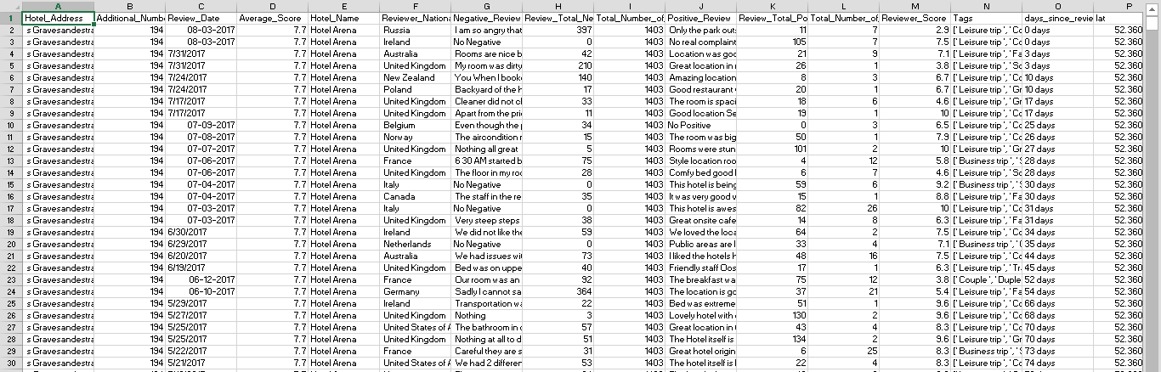
DATASET CONTENT
This dataset contains 515,000 customer reviews and scoring of 1493 luxury hotels across Europe.

Slide 7
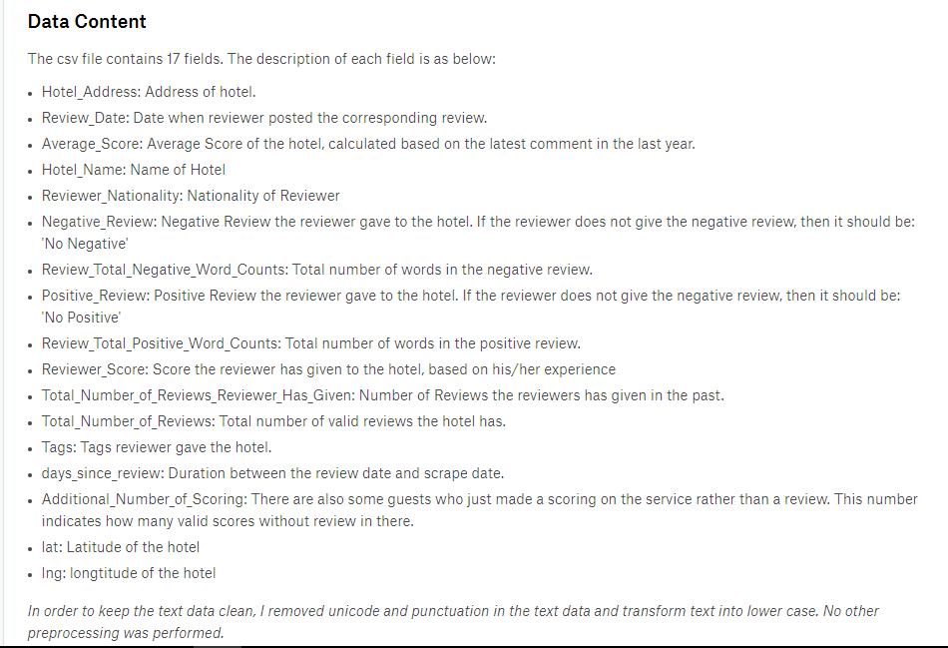
DATASET DESCRIPTION

Slide 8
Tools USED
Rapid Miner
Python
Scikit Learn Library

Slide 9
Algorithms
Naive Bayes (Python and Rapid Miner)
Random Forest(Python)
Deep Learning (Rapid Miner) (High Accuracy)
Gradient Boosting Tree (Rapid Miner)
SVM (Rapid Miner)
GLM (Rapid Miner)

Slide 10
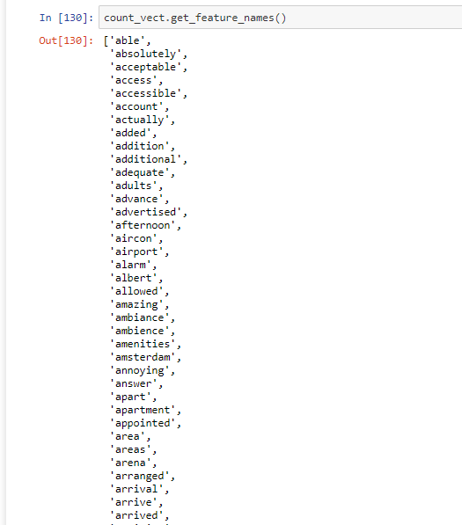
Features Name From TF-IDF

Slide 11

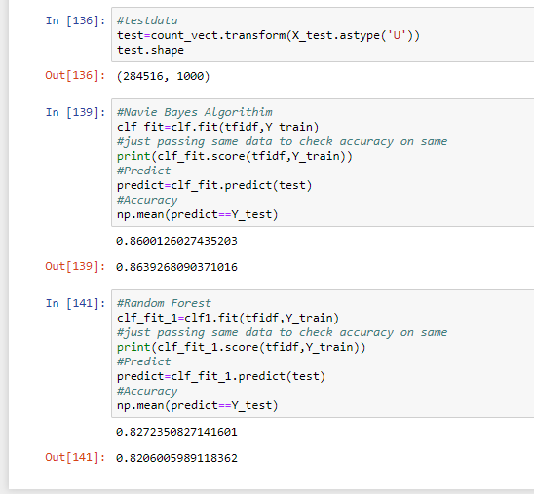
Python Results

Slide 12
Crisp DM Implementation

Slide 13
Rapid Miner

Slide 14
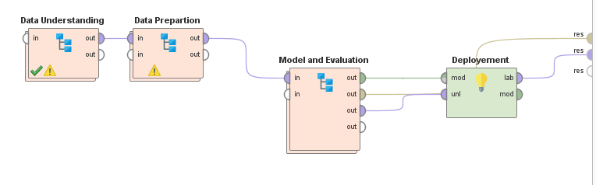
Crisp dm rapid miner

Slide 15
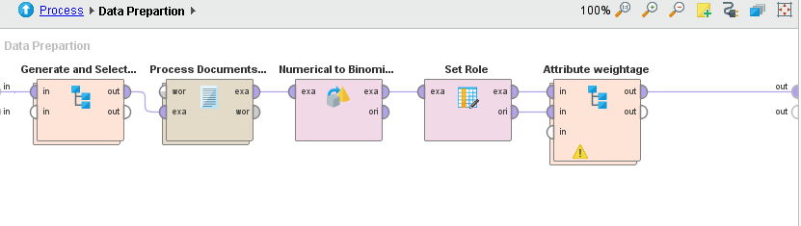
Data preparation stage

Slide 16
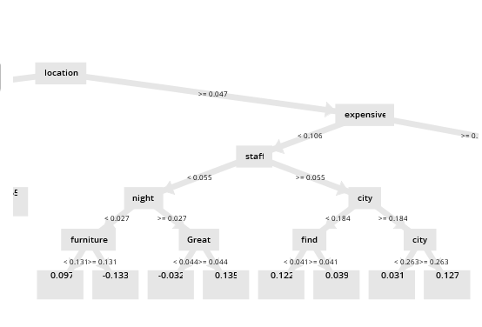
Gradient Boost tree

Slide 17
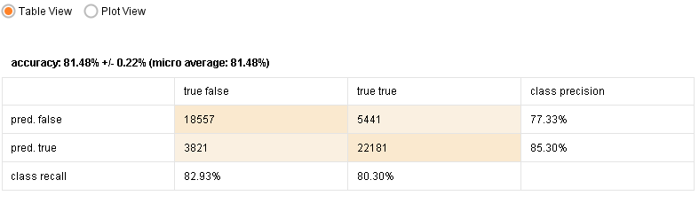
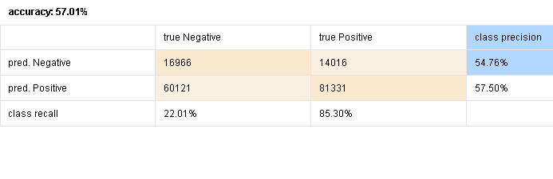
Gradient Boost Tree
Generalized linear model

Slide 18
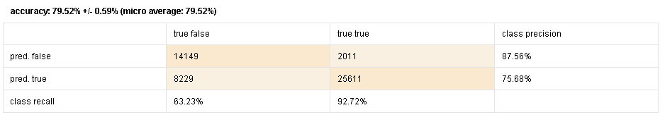
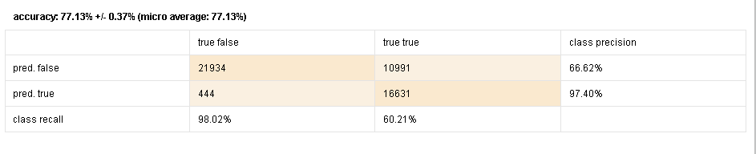
naive
svm

Slide 19
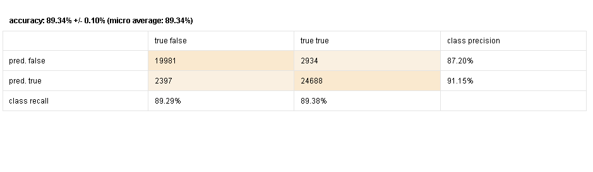
Deep Machine accuracy

Slide 20
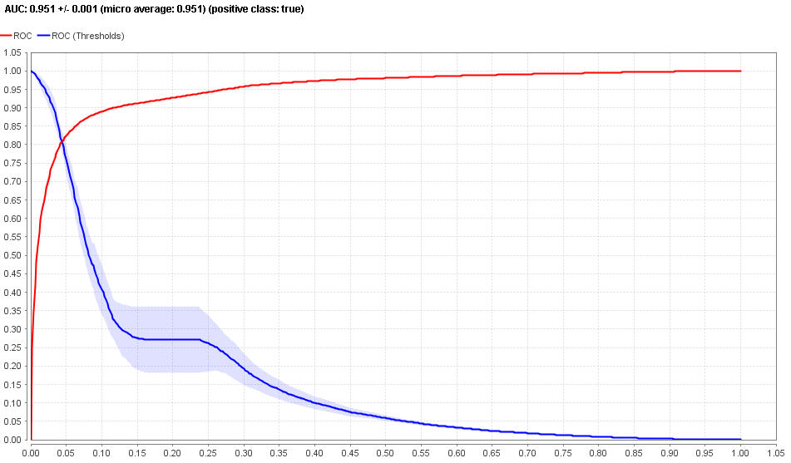
Deep Machine accuracy

Slide 21
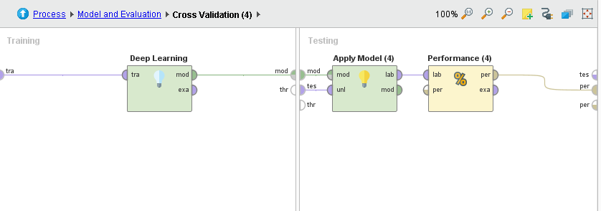
Model and performance evaluation

Slide 22
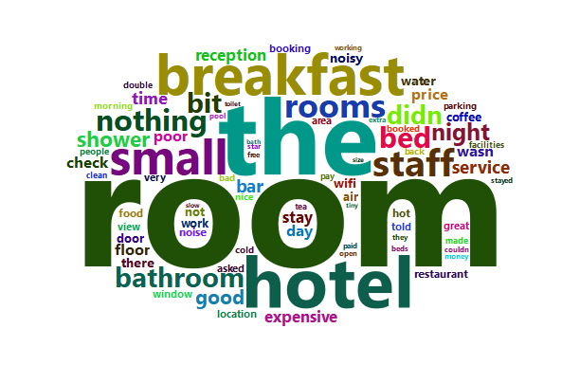
Negative tags

Slide 23
Deployment Stage
We deploy with Deep Learning Model
Deep learning have High Accuracy and its good for business

Slide 24
Thank you

